Slide 1
Robot Operating System - ROS
Introduction

Slide 2

1
What is ROS
2
ROS Basics
3
ROS Architecture
4
ROS Example
Table of contents
5
ROS Organization
6
ROS Activity
7
ROS Launch Files
8
Questions

Slide 3
Robot Operating System - ROS
What is ROS?

Slide 4
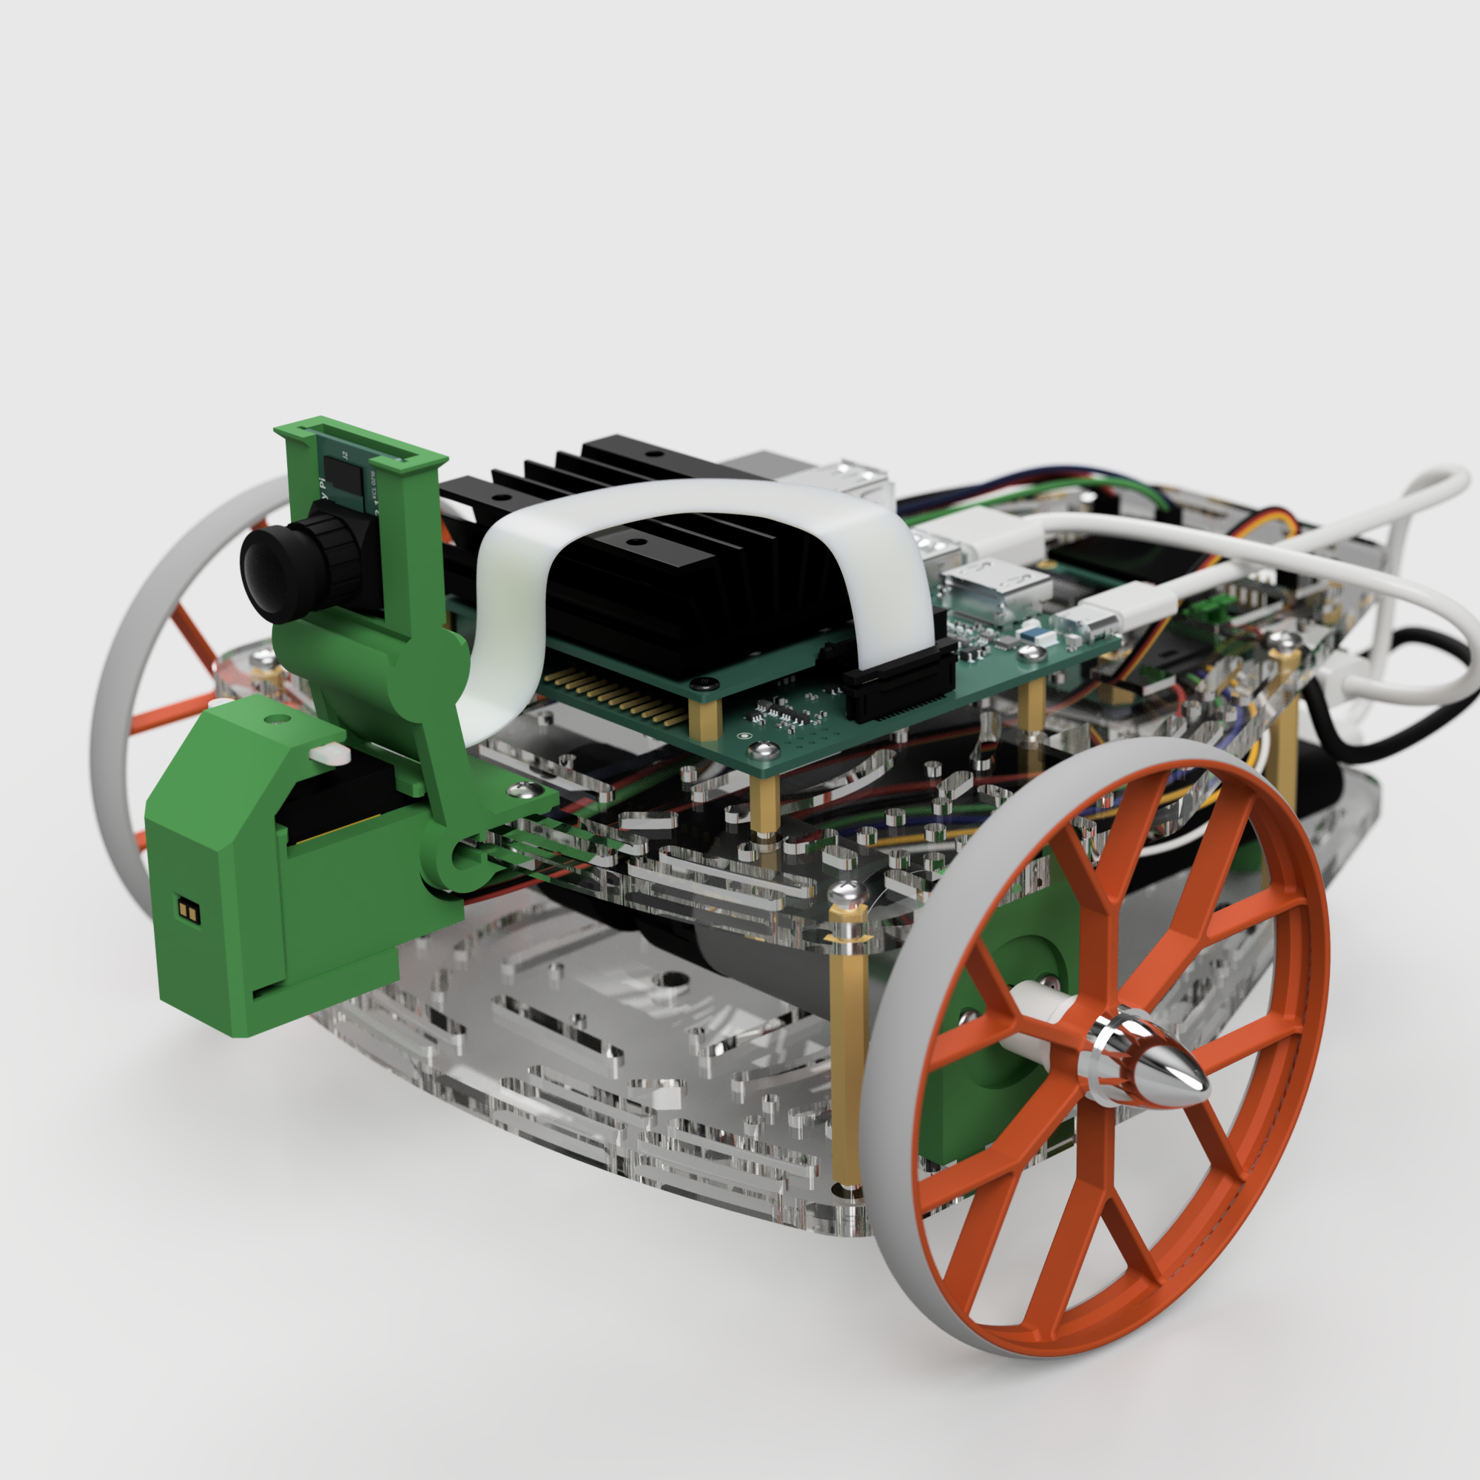
Introduction
Robotics is becoming increasingly complex.
The increasing number of sensors, actuators, and other hardware components used in robotics.
Complex algorithms used in robotics nowadays, from robust control to AI.
There is a need for a flexible, scalable, and reliable communication infrastructure.

Slide 5
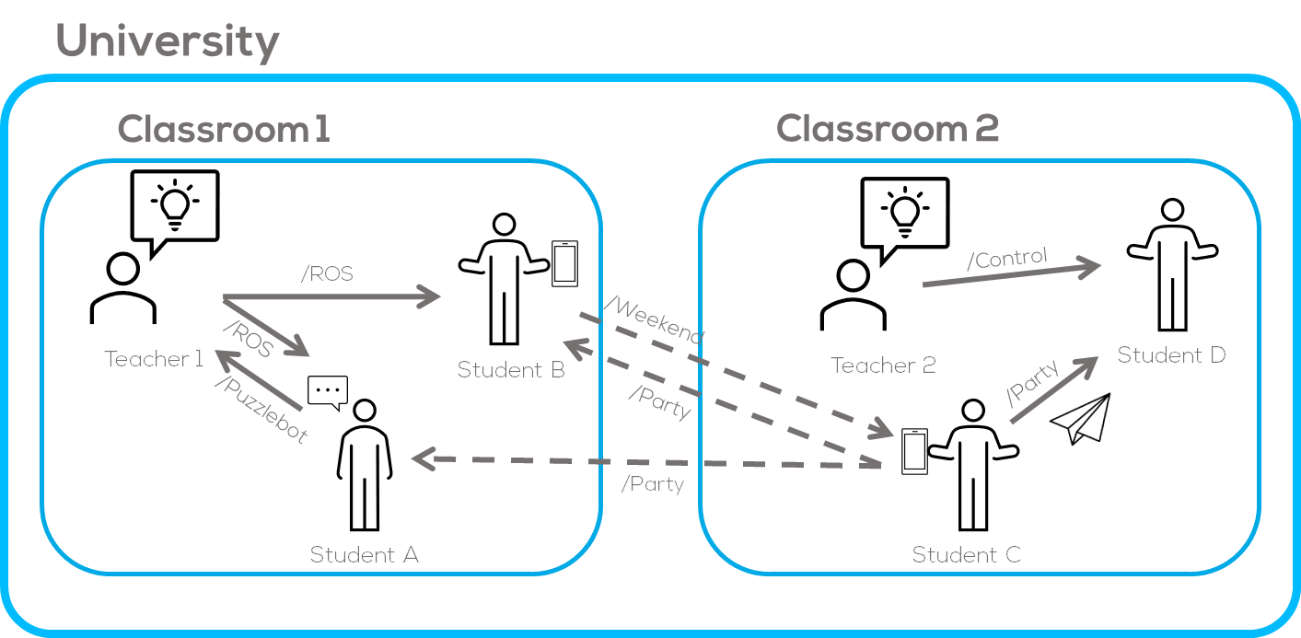
Introduction
** Any resemblance to reality, is purely coincidental.
Notes:
Communication requires
a sender,
a receiver or receivers
a structure
a topic
a message
a medium
a location
Imagine that you are attending the University:
In a university you go to class inside a building and listen to a professor and talk to your classmates. Within the same Building other lecturers are talking to their students; similarly, and at the same time students get to talk to each other about what are they going to make during the weekend and which party are the going to attend.
The infrastructure or location that makes it possible is the University where you attend a certain classroom
The formalities/rules of communication, allows communication to have a structure (not everybody talking at the same time) so that you can listen to the teacher or each other.
The topics is declared in this instance by the professors or by the students when they talk to themselves
The message is the type of message to be used which also contains a structure
Between the professor and students will be a formal message (presentation, speech, etc.)
Between the students will be a more informal message (memes, photos, etc.)
The medium could be physical or digital (voice, paper plane or cellphone)

Slide 6
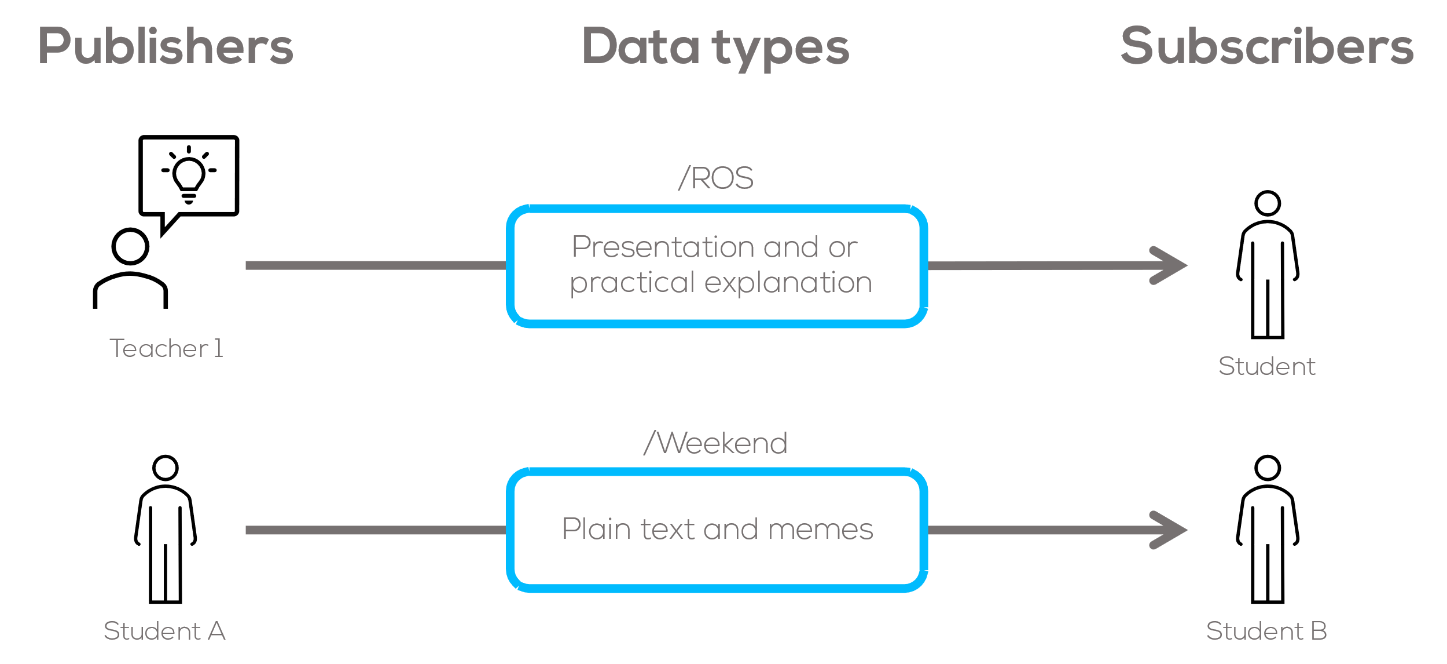
Introduction
How is the information delivered?
The information is delivered through messages inside each topic.
Any message or class has a certain format (is encoded), which both the teacher and the student know off and is expected.
As an example: Between two students, it is expected some simple messages such as plain text, memes or figures.
If the structure of the message is incorrect it would not be possible to understand it.
Notes:
If the structure of a message is wrong you won’t understand it, same happens to ROS.
Each topic has a particular message or data type associated to it.
For the computer they are always 1 and 0, so we need some way to decode it.
Any message shape needs to make sense with the context of the communication, the same happens with ROS

Slide 7
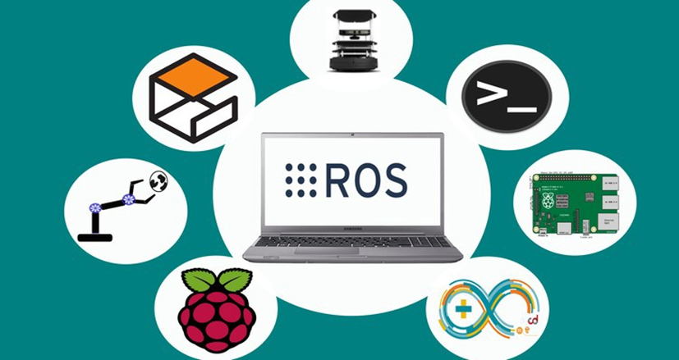
What is ROS?
What is ROS?
“ROS is a set of software libraries and tools for building robot applications. From drivers and state-of-the-art algorithms to powerful developer tools, ROS has the open-source tools you need for your next robotics project.”
ROS is designed to be an open, scalable, and Interoperable framework for building robot applications.
Notes:
Basically, define ROS In one sentence to place the students, What is ROS and Where is it used
Move onto the example, something like so that you can understand it better.

Slide 8
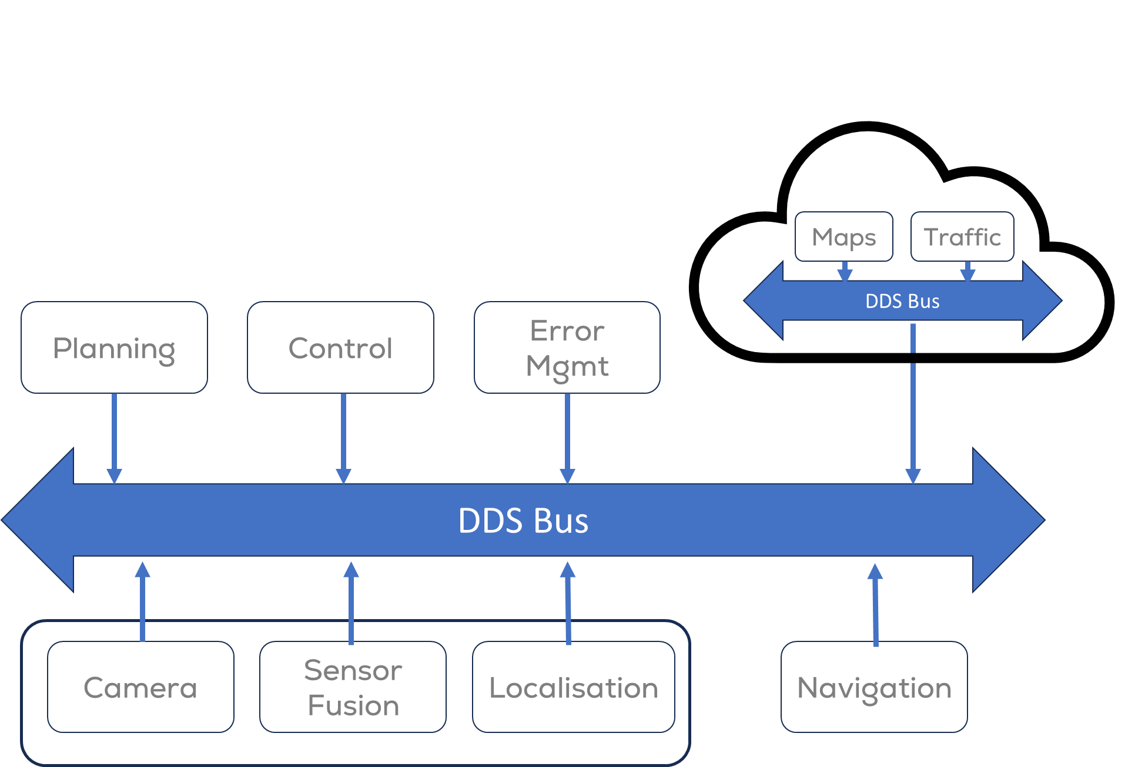
What is ROS? Let’s be more technical
What is ROS?
ROS 2 (Robot Operating System 2) is an open-source robotics middleware framework and tools.
A middleware is a software layer facilitating communication and data exchange between distributed systems.
Utilises DDS (Data Distribution Service) for robust communication.
Manages message passing and ensures efficient communication.
Abstracts underlying complexities for developers.
Notes:
https://design.ros2.org/articles/ros_on_dds.html
DDS is a networking middleware that simplifies complex network programming. It implements a publish–subscribe pattern for sending and receiving data, events, and commands among the nodes. Nodes that produce information (publishers) create "topics" (e.g., temperature, location, pressure) and publish "samples". DDS delivers the samples to subscribers that declare an interest in that topic.
DDS handles transfer chores: message addressing, data marshalling and de-marshalling (so subscribers can be on different platforms from the publisher), delivery, flow control, retries, etc. Any node can be a publisher, subscriber, or both simultaneously.
The DDS publish-subscribe model virtually eliminates complex network programming for distributed applications. ^{[citation needed]}
DDS supports mechanisms that go beyond the basic publish-subscribe model. ^{[citation needed]} The key benefit is that applications that use DDS for their communications are decoupled. Little design time needs be spent on handling their mutual interactions. In particular, the applications never need information about the other participating applications, including their existence or locations. DDS transparently handles message delivery without requiring intervention from the user applications, including:
determining who should receive the messages
where recipients are located
what happens if messages cannot be delivered
DDS allows the user to specify quality of service (QoS) parameters to configure discovery and behavior mechanisms up-front. By exchanging messages anonymously, DDS simplifies distributed applications and encourages modular, well-structured programs. ^{[citation needed]} DDS also automatically handles hot-swapping redundant publishers if the primary fails. ^{[citation needed]} Subscribers always get the sample with the highest priority whose data is still valid (that is, whose publisher-specified validity period has not expired)^{[citation needed]}. It automatically switches back to the primary when it recovers, too^{[citation needed]}.

Slide 9
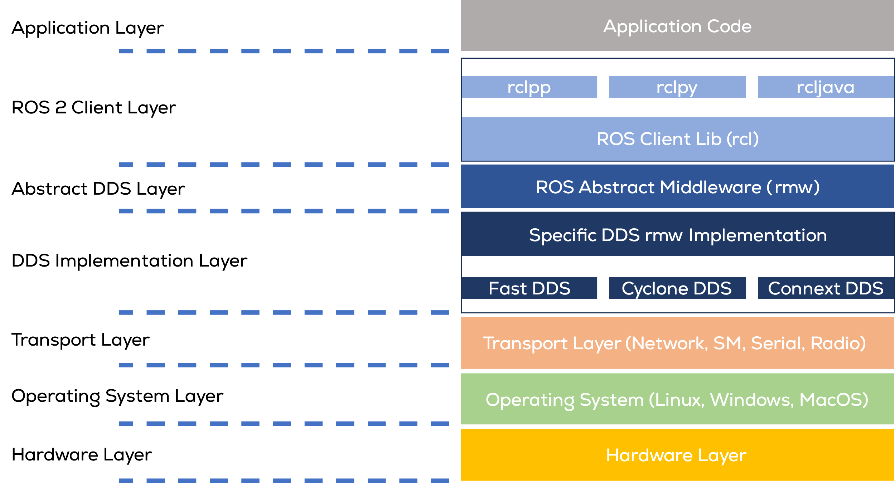
ROS Architecture
ROS comprises of various software layers, that provide the infrastructure for building and running robot applications.
These layers work together to provide a high-level interface for building and running robot applications.
DDS (Data Distribution Service) is a middleware that provides a high-performance, scalable, and secure way for nodes to exchange data and communicate with each other.
rmw (ROS Middleware) is a middleware layer that abstracts the complexity of DDS.
rcl (ROS Client Library) is a middleware layer that provides a high-level interface for building and running robot applications using rmw.
Rclcpp/rclpy is a C++/Python implementation of rcl that provides a set classes and functions for building and running robot applications using rcl.
Notes:
DDS is a networking middleware that simplifies complex network programming. It implements a publish–subscribe pattern for sending and receiving data, events, and commands among the nodes.
Nodes that produce information (publishers) create "topics" (e.g., temperature, location, pressure) and publish "samples".
DDS delivers the samples to subscribers that declare an interest in that topic.
DDS handles transfer chores: message addressing, data marshalling and de-marshalling (so subscribers can be on different platforms from the publisher), delivery, flow control, retries, etc. Any node can be a publisher, subscriber, or both simultaneously.
The DDS publish-subscribe model virtually eliminates complex network programming for distributed applications.
DDS supports mechanisms that go beyond the basic publish-subscribe model.
The key benefit is that applications that use DDS for their communications are decoupled.
Little design time needs be spent on handling their mutual interactions.
In particular, the applications never need information about the other participating applications, including their existence or locations. DDS transparently handles message delivery without requiring intervention from the user applications, including:
determining who should receive the messages
where recipients are located
what happens if messages cannot be delivered
DDS allows the user to specify quality of service (QoS) parameters to configure discovery and behavior mechanisms up-front. By exchanging messages anonymously, DDS simplifies distributed applications and encourages modular, well-structured programs. DDS also automatically handles hot-swapping redundant publishers if the primary fails. [
Subscribers always get the sample with the highest priority whose data is still valid (that is, whose publisher-specified validity period has not expired)
It automatically switches back to the primary when it recovers, too.

Slide 10
Robot Operating System - ROS
ROS Architecture

Slide 11

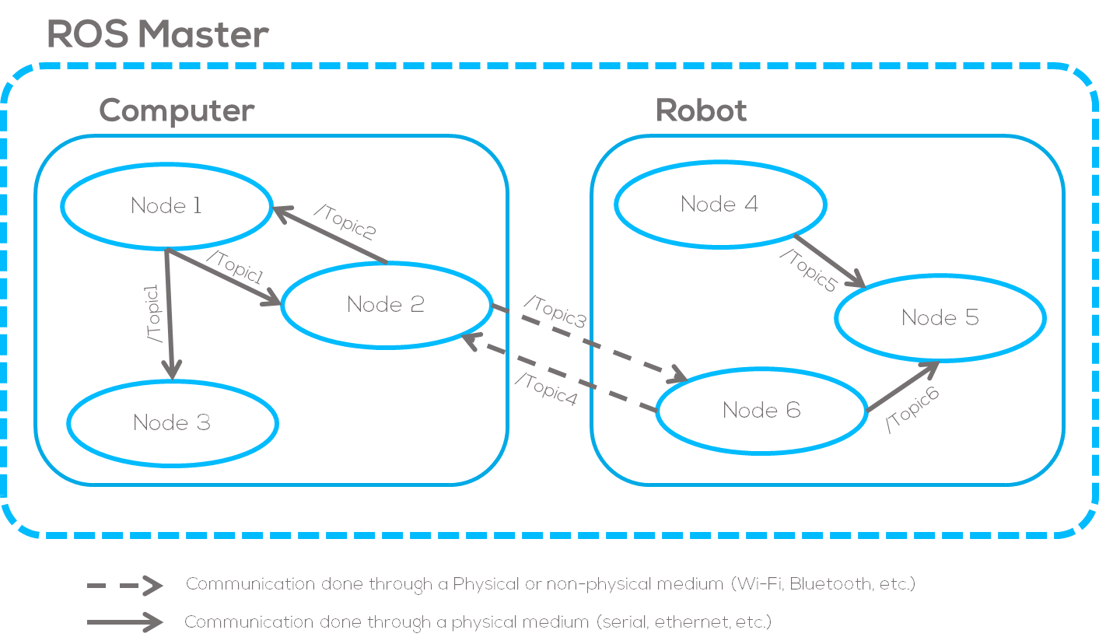
How ROS Works
Communication Model
ROS communication model is loosely based on the previous analogy.
Where the persons may represent a piece of software (code) that acts as an element in the network called “Nodes”.
Sharing messages (data) amongst these Nodes is done via topics and subscribers.
ROS offers three different communication architectures Publisher-Subscriber, Services or Actions.

Slide 12
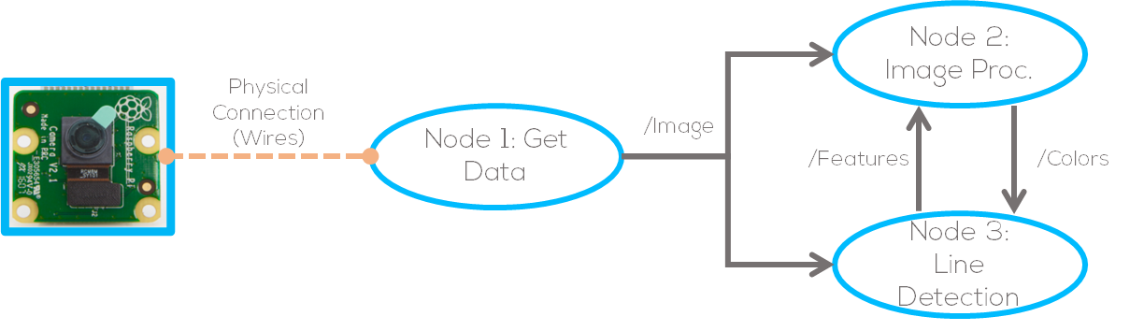
Nodes
Fundamental ROS 2 element that serves a single, modular purpose in a robotics system
Wheel control
Camera
Processing
It is a piece of software that acts as an element in the network.
Executes part of a code and can be programmed in C++ or Python.

Slide 13
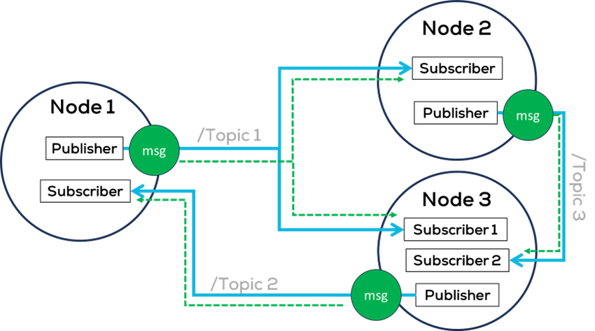
Topics
Topics or Buses, are a vital element of the ROS graph that act as a bus for nodes to exchange messages.
Topics are one of the main ways in which data is moved between nodes and therefore between different parts of the system.

Slide 14
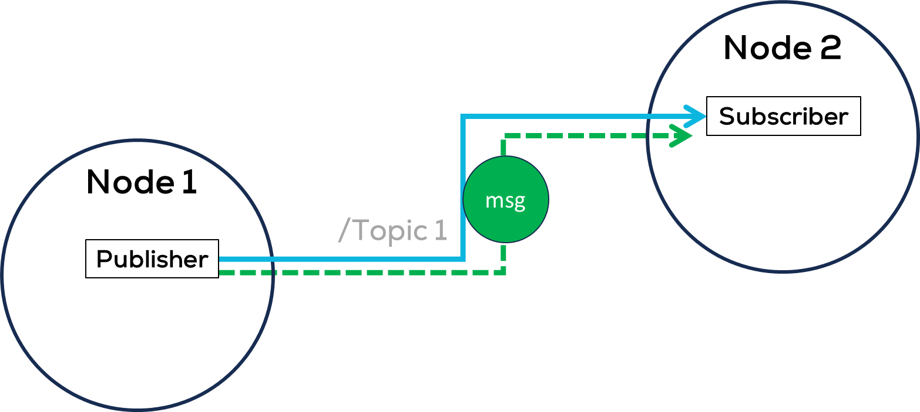
Interface (Messages)
Messages are the bits of data that are sent from one node to another over a topic.
They provide a structure for the data being sent.
Publishers and subscribers must send and receive the same type of message to communicate.
Many types of data are supported such as integers, floating point, Boolean, etc.
Messages can include nested structures and arrays.

Slide 15
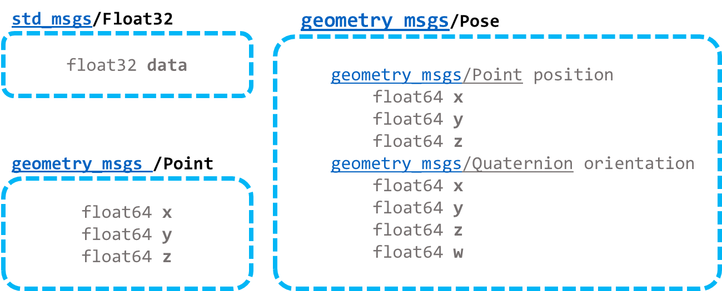
Interface (Messages)
Notes:
Talk about how msgs. can be 1 variable, vectors of variables and can embed different msg types

Slide 16
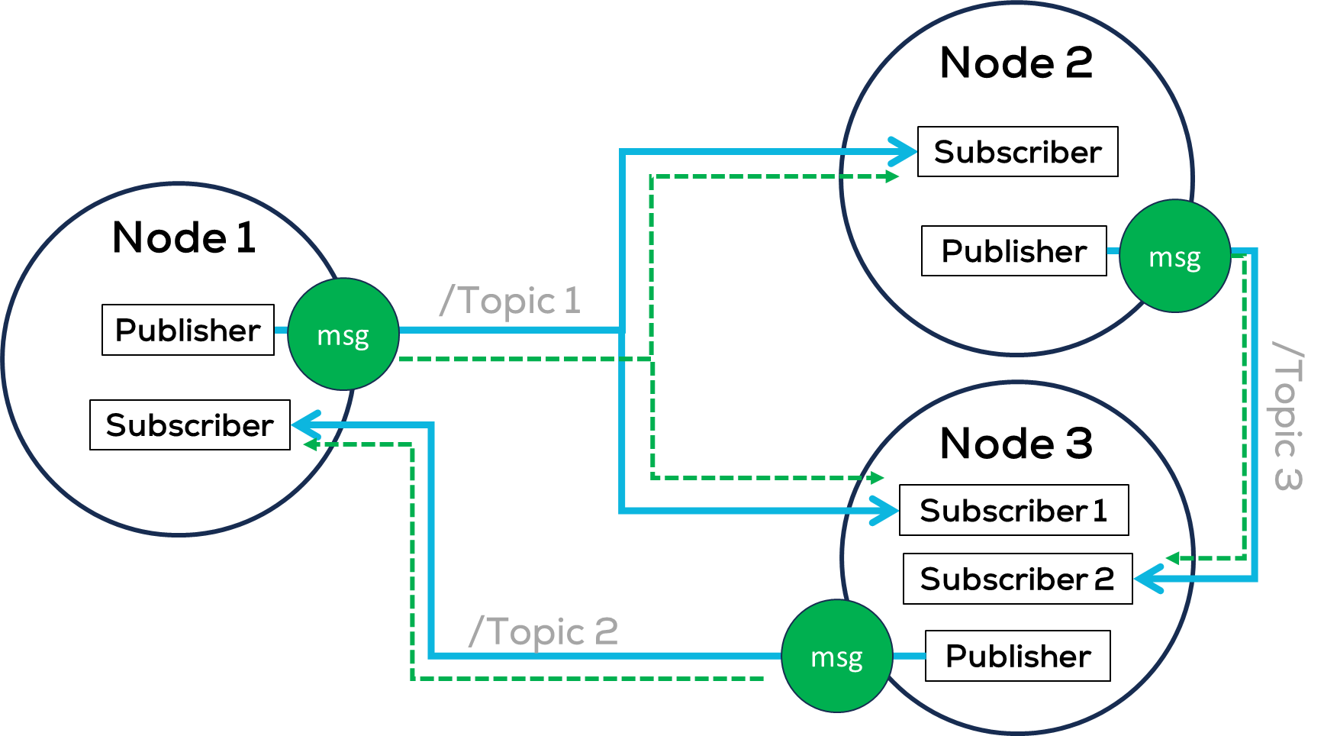
Communication
Publisher and Subscriber:
Sending a message in a certain topic is called a “publishing”.
Receiving a message from a certain topic is called a “subscribing”.
Publishers are objects created inside each node to send a message to a topic.
Subscribers are objects created inside each node to “subscribe” to the topic so it can receive messages. The subscriber will then get any messages that are posted to that topic.
Publisher- Subscriber Architecture

Slide 17
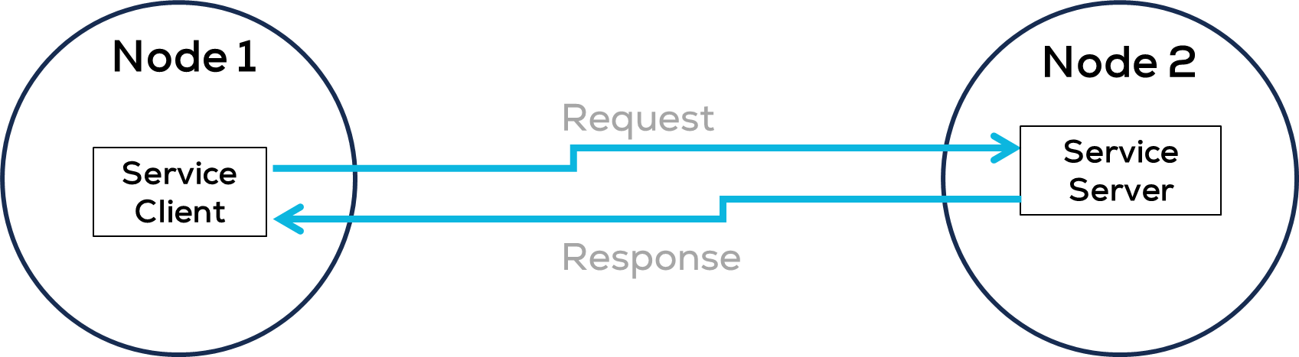
How ROS Works
Services
A service is a way for nodes to request specific computation or data from other nodes and receive a response.
Services are implemented using a request-response messaging pattern.
A node (Node 1) request a computation or data (the client) by sending a request message to another node (the server), which performs the computation or retrieves the data and sends a response message back to the client.

Slide 18
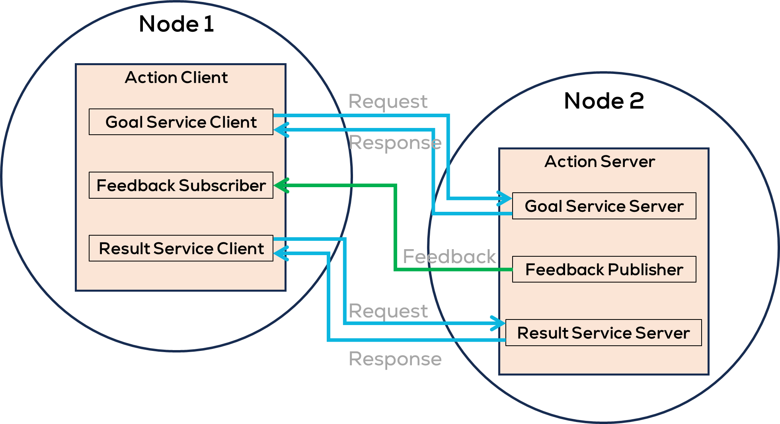
How ROS Works
Actions
Actions are intended for long running tasks.
They consist of three parts: a goal, feedback, and a result.
Actions are a combination of publishers/subscribers and services. They work as follows:
Node 1 “action client” sends a Goal request to Node 2 “action server”.
Node 2 “action server” acknowledges the goal and sends a response.
Node 1 (client) sends a Result Request to the Node 2 (server).
Node 2 returns a stream of feedback using a publisher and Node 1 subscribes to the data feedback.
Node 2 (server) sends the response with the result to the client.
Actions, unlike services, can be cancelled while executing (preemtable).

Slide 19
Robot Operating System - ROS
ROS Example

Slide 20
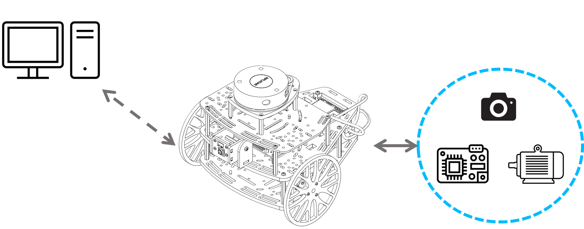
ROS Practical Example
The system presented is a mobile robot called Puzzlebot® by Manchester Robotics.
The robot is comprised of an on-board computing unit from NVIDIA the Jetson Nano used for high level control algorithms and a microcontroller for low level control tasks.
The robot also contains different sensors and actuators such as motors, encoders, and cameras.

Slide 21
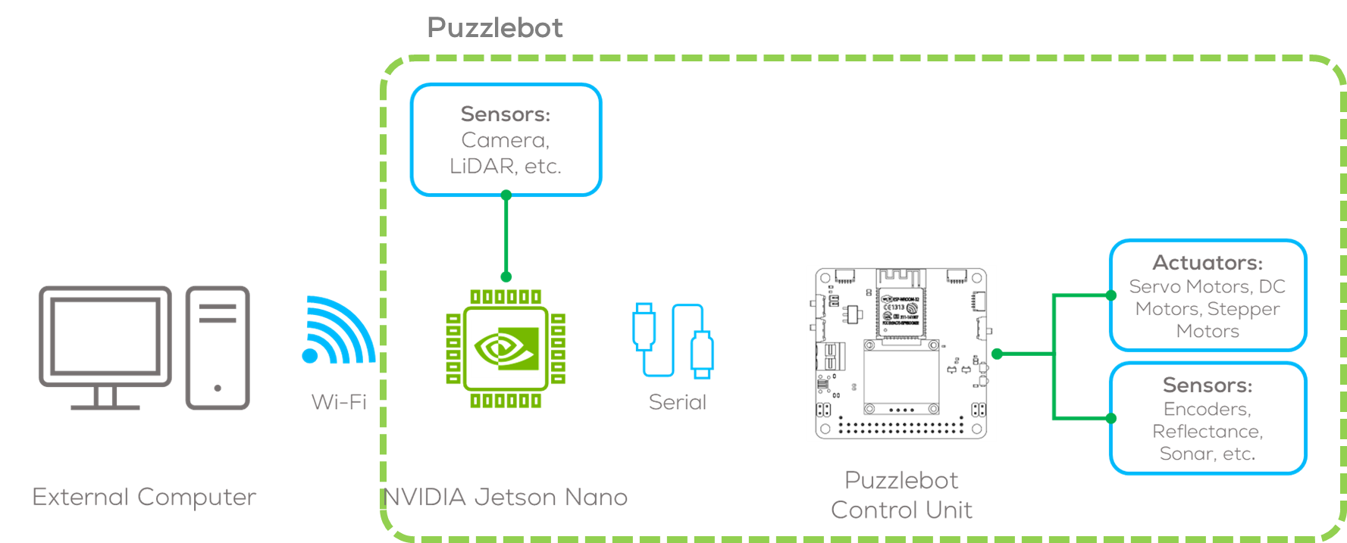
ROS Practical Example
The robot is controlled by a computer running a ROS node and communicated to the robot via Wi-Fi.
The on-board computer runs Ubuntu as OS and uses ROS nodes to perform different tasks and communicate with the external computer, microcontroller and the peripherals.
The microcontroller contains several ROS nodes and provides access to the sensors and actuators.

Slide 22
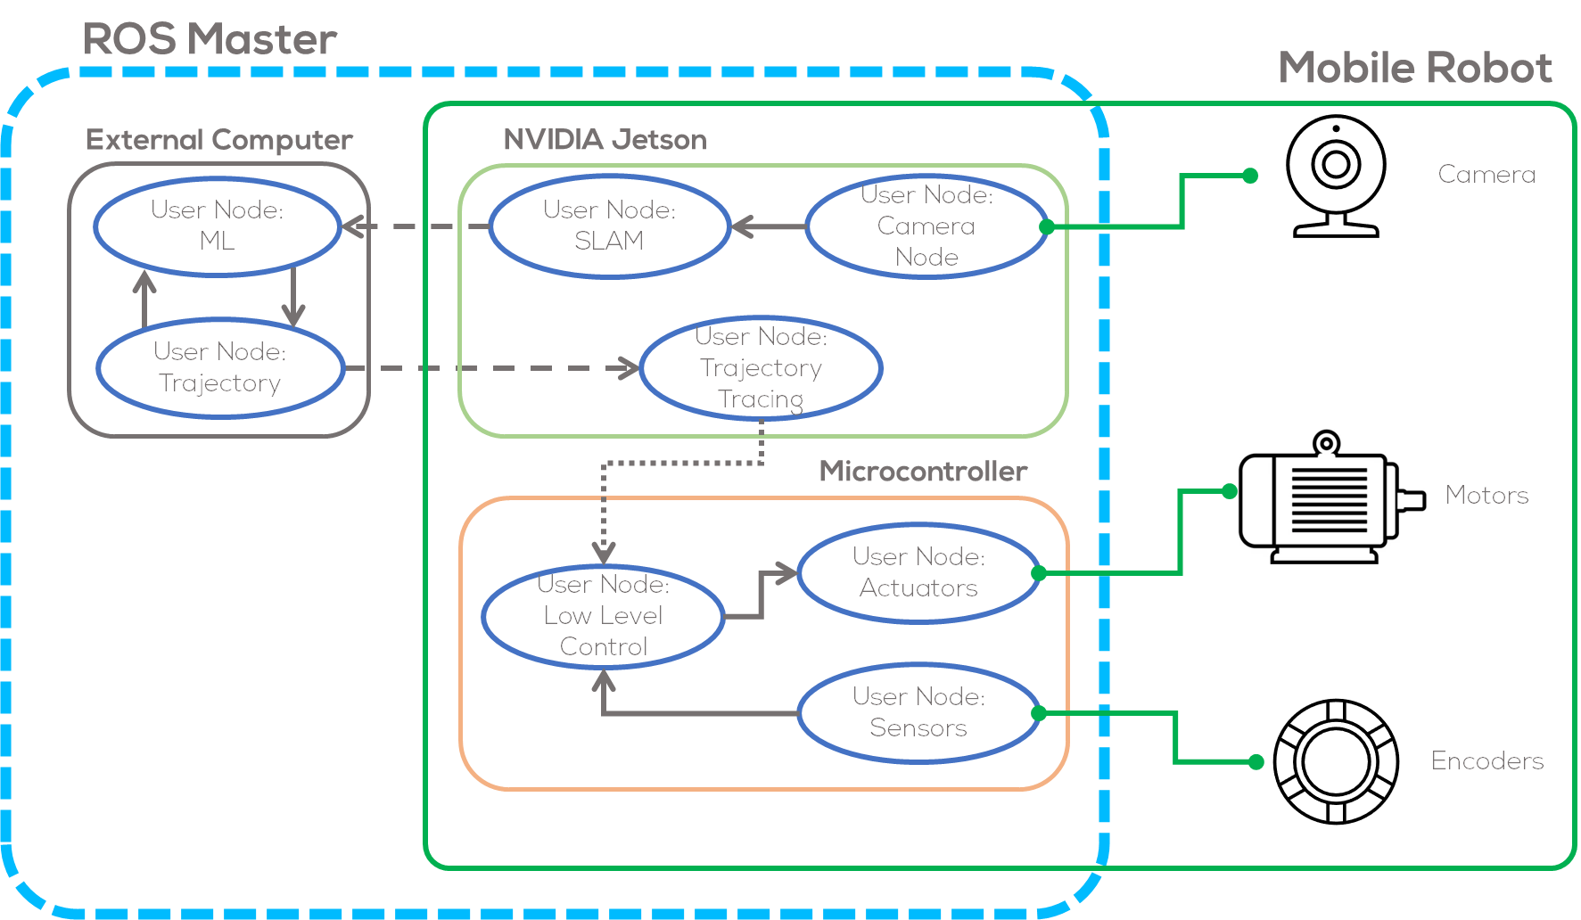
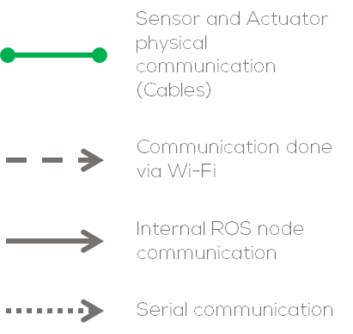
ROS Example

Slide 23
Robot Operating System - ROS
ROS Organization

Slide 24
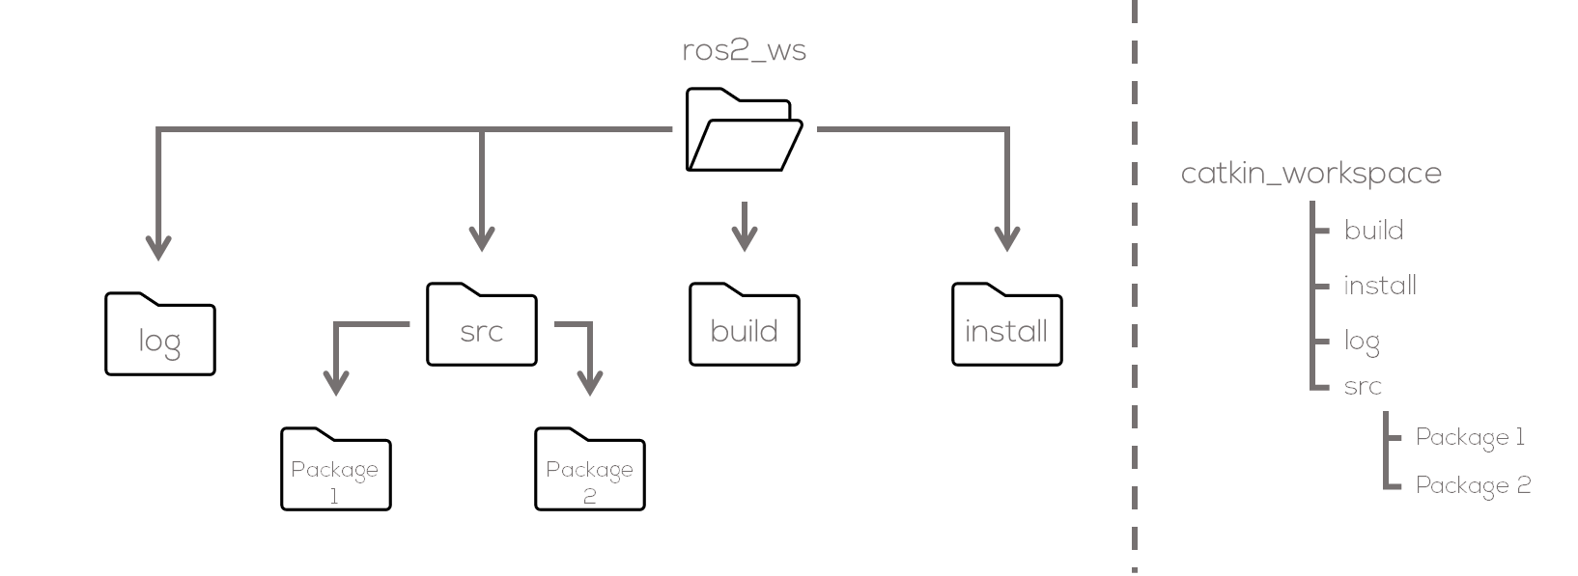
ROS Organization
ROS Workspace
We have seen some of the components of ROS. But how are they organized/represented in the computer?
ROS projects are organized in workspaces, which are a collection of grouped codes called packages.
A workspace is a set of directories (or folders) where you store related pieces of ROS code (ROS Packages).
Notes:
We have explained the architectural components of ROS, but how are they actually organized in the computer.
ROS has a workspace, in order to develop its projects.
The workspace is called catkin workspace (can be any name)

Slide 25
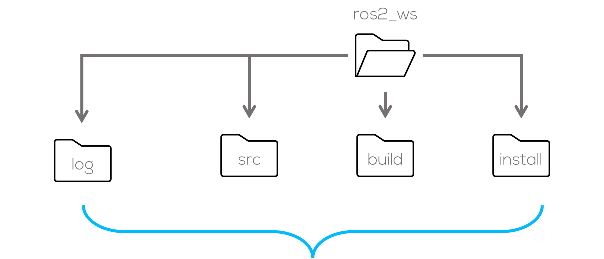
ROS Organization: Workspace
The build directory will be where intermediate files are stored. For each package a subfolder will be created in which e.g. CMake is being invoked.
The install directory is where each package will be installed to. By default, each package will be installed into a separate subdirectory.
The log directory contains various logging information about each colcon invocation.
The src subdirectory. Inside that subdirectory is where the source code of ROS packages will be located. Typically, the directory starts empty.

Slide 26
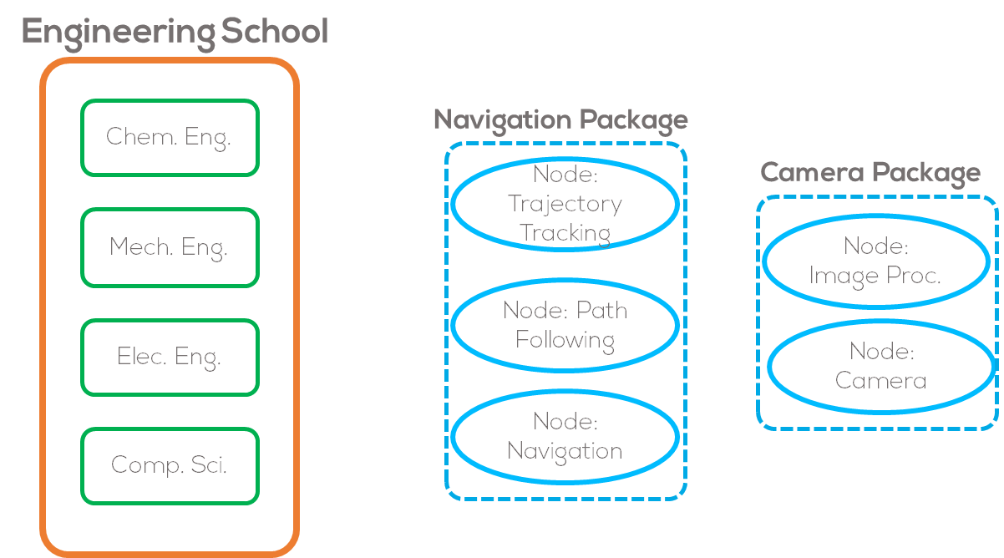
ROS Organization: Packages
ROS Packages
To keep everything more organized, ROS uses the concept of packages.
ROS Packages are a way of organizing code related between each other. They can be considered as a container for ROS code.
The same way teachers are gathered within the engineering school nodes are gathered in ROS packages.
Another analogy related with the university, could be the types of students. In this case, the students who pay attention can be one package and the ones who don’t could be another package.
Notes:
The way of explaining packages will be relating it to a school in the University, different ”families” within engineering
Another analogy related with the University, could be the types of students. In this case, the students who pay attention can be one package and the ones who don’t could be another package.

Slide 27
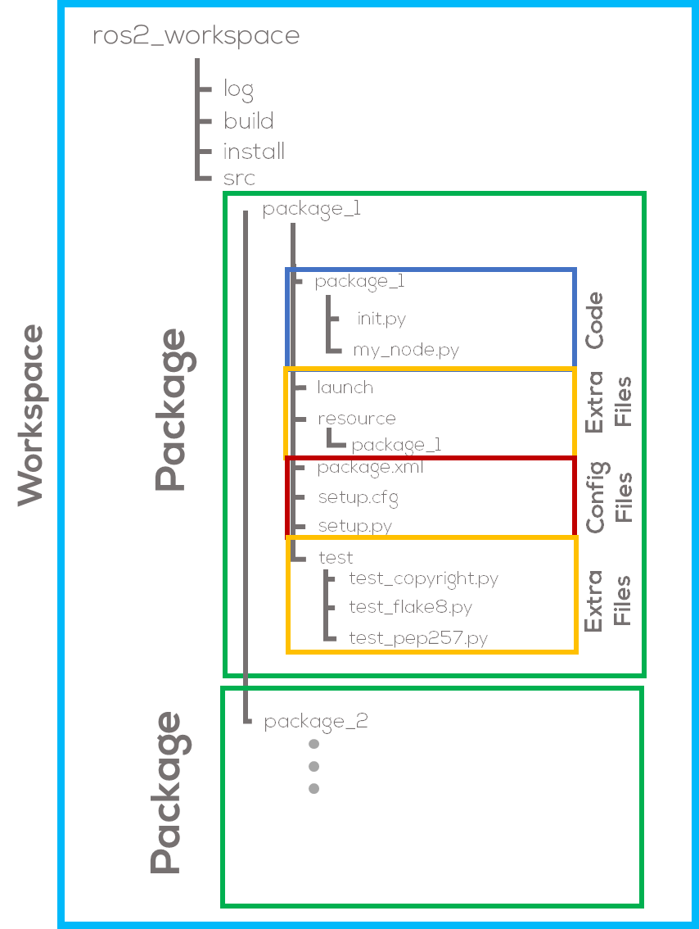
ROS Organization
ROS Packages
Each package in ROS requires different attributes to be compiled.
These attributes are usually dependencies related with other packages, external libraries or custom messages, services and actions.
ROS uses ament as its build system and Colcon as its build tool.
CMake or Python can be used to create a package.
Instructions for the compiler need to be allocated in CMake and Package files.
Notes:
The way of explaining packages will be relating it to a school in the University, different ”families” within engineering
Another analogy related with the University, could be the types of students. In this case, the students who pay attention can be one package and the ones who don’t could be another package.

Slide 28
Packages in a workspace
A single workspace can contain as many packages as wanted, each in their own folder.
A workspace can also have packages of different build types in one workspace (CMake, Python, etc.). You cannot have nested packages.
Best practice is to have a src folder within your workspace, and to create your packages in there. This keeps the top level of the workspace “clean”.

Slide 29
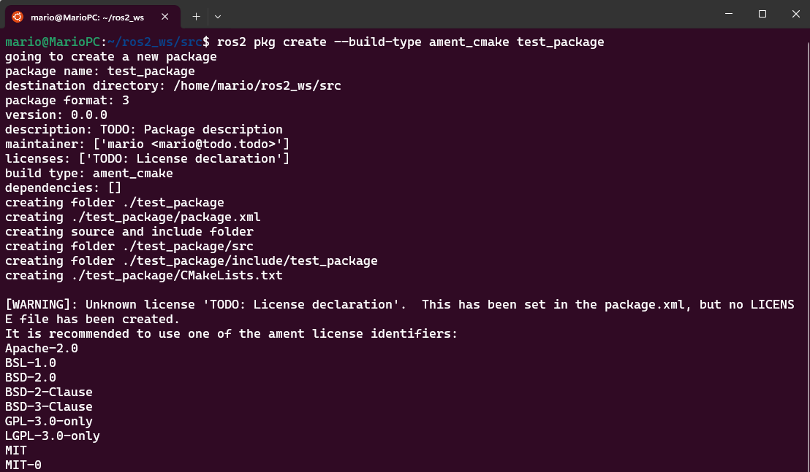
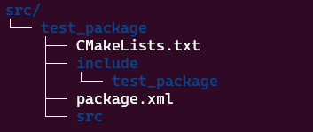
ROS2 CMake Package Command Line
To create a package in C++
Minimum required content:
package.xml file containing meta information about the package
CMakeLists.txt file that describes how to build the code within the package
$ ros2 pkg create --build-type ament_cmake <package_name>

Slide 30
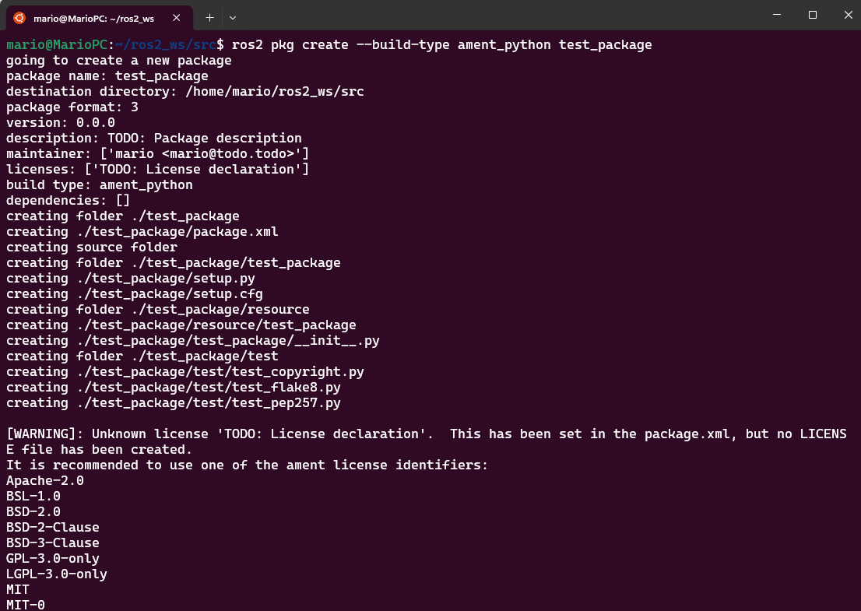
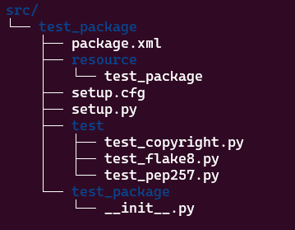
ROS2 Python Package Command Line
package.xml file containing meta information about the package
setup.py containing instructions for how to install the package
setup.cfg is required when a package has executables, so ros2 run can find them
/<package_name> - a directory with the same name as your package, used by ROS 2 tools to find your package, contains __init__.py
To create a package with Python
$ ros2 pkg create --build-type ament_python <package_name>

Slide 31
ROS Organization
A Closer Look Into a ROS Package
Packages: Files that can be exported between projects
Configuration files used to stablish code dependencies.
Extra files and folders: They are files/folders dedicated for specific tasks. In this case the launch file allow us to execute several nodes at the same time
Nodes : Code that we will execute inside each node.

Slide 32
Robot Operating System - ROS
Creating a Workspace

Slide 33
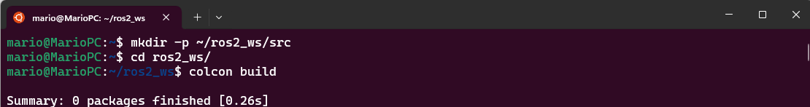
Create a workspace
Creating a workspace
Open a terminal in Ubuntu
Source the ROS2 underlay
Create a directory to contain our workspace
Access the created folder
From the root of your workspace (ros2_ws), you can now build your packages using the command:
colcon does out of source builds. By default, it will create the build, install and log directories as peers of the src directory
$ colcon build
$ source /opt/ros/$DISTRO$/setup.bash
replace $DISTRO$ for the name of your distribution e.g.:
$ source /opt/ros/humble/setup.bash
$ mkdir -p ~/ros2_ws/src
$ cd ~/ros2_ws/src

Slide 34
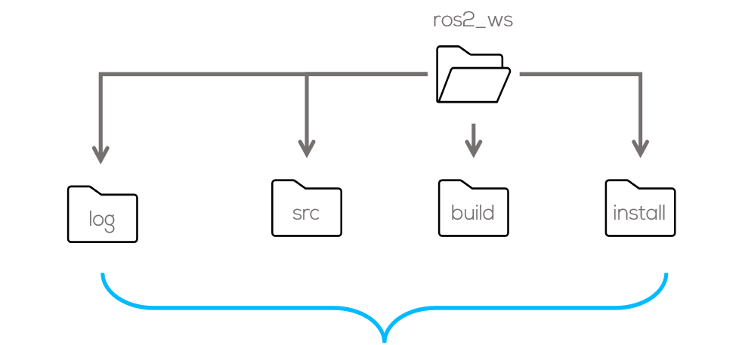
Create a workspace
Before you can use any of the installed executables or libraries, you will need to add them to your path and library paths.
Colcon will have generated bash/bat files in the install directory to help setup the environment.
These files will add all of the required elements to your path and library paths as well as provide any bash or shell commands exported by packages.
$ source install/setup.bash

Slide 35
ROS Activities
Activity #1 : Talker –Listener

Slide 36
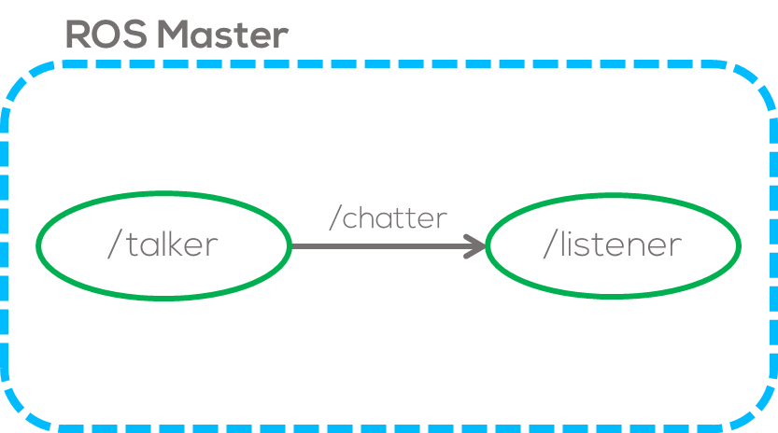
ROS Activity 1
Talker - Listener framework
In this activity, the student will learn about nodes, topic and messages.
The simplest task to perform in ROS is to communicate 2 nodes.
The first node to be created will be the “talker” node. This node will send a simple message inside the topic “/chatter”.
The second node to be programmed, will be the “listener” node. This node will subscribe to the topic “/chatter” of the “talker” node and print on the screen the message.

Slide 37
ROS Activity 1
Requirements
Ubuntu in VM (MCR2 VM), dual booting or wsl.
ROS installed (if not follow the steps in this link and select full installation)
Workspace “ros2_ws” created following the previous steps.
Creating a package
The easiest way to create a package is to use the ROS tool pkg create.
For this exercise, create a package called basic_comms. The node name should be talker. Open a terminal and type the following
Beware that the command “ros2 pkg create” must be run inside the “src” folder.
Once the package is created you will be able to see the package folder in ~/ros2_ws/src.
Build the package you just created and add it to your environment
$ ros2 pkg create --build-type ament_python <package_name>
$ cd ~/catkin_ws/src
$ ros2 pkg create --build-type ament_python --node-name talker basic_comms
$ cd ~/ros2_ws
$ colcon build
$ source install/setup.bash
Notes:
Remark that they should be aware of where they create things (if they run create package outside home the rest of the terminal commands wont work)
Remark that they need to source each terminal or add it to their bash file

Slide 38
ROS Activity 1
Check the executable that was recently created
The following information should be published on the screen
Creating and Configuring the Talker Node
If not created automatically, create the publisher node file in ~/ros2_ws/src/basic_comms/basic_comms
Since the “talker.py” is an executable script, you need give permission to ubuntu to run it.
Recall that this directory is a Python package with the same name as the ROS 2 package it’s nested in.
Open talker.py in a text editor (e.g. gedit, vscode, vim, …)
$ ros2 run basic_comms talker
$ ~/ros2_ws/src/basic_comms/basic_comms
$ touch talker.py
$ sudo chmod +x *
Use * to give permission to all files inside a folder

Slide 39
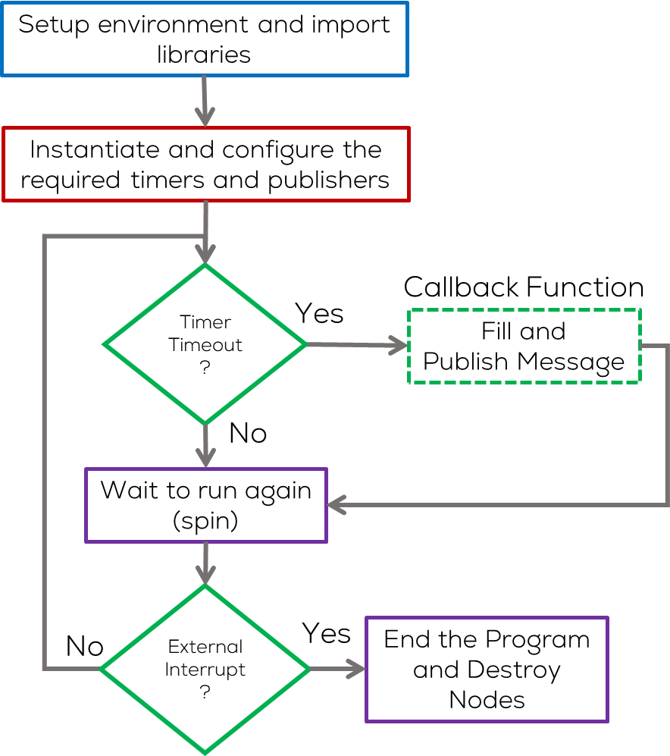
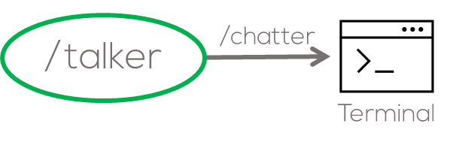
ROS Activity 1
Coding the Talker node
This node will publish a message (string) into the “/chatter” topic.
To start, the message will be seen in the terminal to verify that the node is working properly (debug).
A graphical representation of this task will look as follows
Nodes in ROS usually have a structure when programmed.
Your code will be written in the file “talker.py”.

Slide 40
Option 1: OOP – Talker node (Recommended)
# Imports
import rclpy
from rclpy.node import Node
from std_msgs.msg import String
#Class Definition
class MinimalPublisher(Node):
def __init__(self):
super().__init__('talker_node')
self.publisher = self.create_publisher(String, 'chatter', 10)
timer_period = 0.5 #seconds
self.timer = self.create_timer(timer_period, self.timer_cb)
self.i = 0
#Timer Callback
def timer_cb(self):
msg = String()
msg.data = 'Hello World: %d' %self.i
self.publisher.publish(msg)
self.get_logger().info('Publising: "%s"' % msg.data)
self.i +=1
#Main
def main(args=None):
rclpy.init(args=args)
minimal_publisher = MinimalPublisher()
try:
rclpy.spin(minimal_publisher)
except KeyboardInterrupt:
pass
finally:
if rclpy.ok():
rclpy.shutdown()
minimal_publisher.destroy_node()
#Execute Node
if __name__ == '__main__':
main()
Imports
Main
Imports
Constructor
Create class
User Stop
(Keyboard Interrupt)
Timer callback
Destroy Node
Callback Function
Execute code

Slide 41
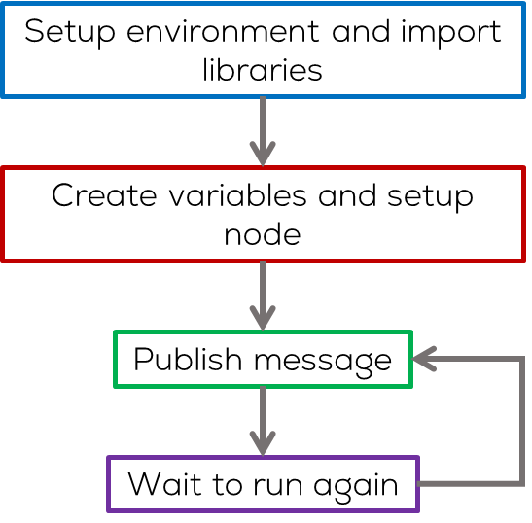
Option 2: Old School– Talker node (Not Recommended)
import rclpy
from rclpy.executors import ExternalShutdownException
from time import sleep
from std_msgs.msg import String
def main(args=None):
try:
rclpy.init(args=args)
node = rclpy.create_node('minimal_publisher') publisher = node.create_publisher(String, 'topic', 10) msg = String()
i = 0
while rclpy.ok():
msg.data = 'Hello World: %d' % i
i += 1
node.get_logger().info('Publishing: "%s"' % msg.data)
publisher.publish(msg)
sleep(0.5) # seconds
except (KeyboardInterrupt, ExternalShutdownException):
pass
finally:
if rclpy.ok(): # Ensure shutdown is only called once
rclpy.shutdown()
node.destroy_node()
if __name__ == '__main__':
main()
Imports
Imports
Main
Constructor
Execute code
Fill message
Publish
Timer callback
Destroy Node

Slide 42
Add dependencies
Open package.xml with your text editor.
After the license, add the following dependencies corresponding to your node’s import statements:
Exec dependencies are packages or libraries needed when running the package, not just for building it.
Open the setup.py file
Verify that the entry points are added correctly, if not add them yourself.
An entry point is the name of the python scripts that are available to run from with the package, and are shown in the list when you type
entry_points={
'console_scripts': [
'talker = basic_comms.talker:main’
],
},
<exec_depend>rclpy</exec_depend>
<exec_depend>std_msgs</exec_depend>
$ ros2 run <my_py_pkg> <executable (entry_point)>

Slide 43
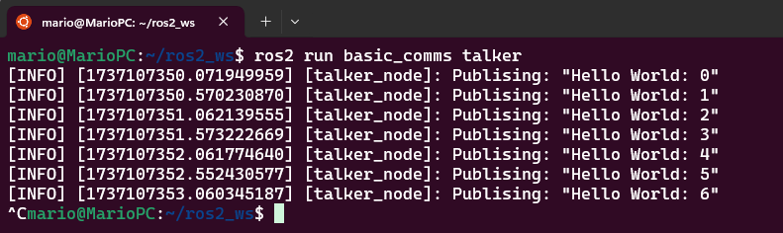
ROS Exercise 1 – Running the node
Results
Running the node
Open a terminal and build your package
Open a new terminal and run the node
To visualize the output of the node, open another terminal and use the command “echo” as follows
$ cd ~/ros2_ws
$ colcon build --symlink-install
$ source install/setup.bash
$ ros2 run basic_comms talker
Press “Ctrl+c” at each open terminal to stop the nodes and ROS
$ ros2 topic echo /chatter

Slide 44
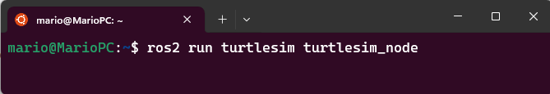
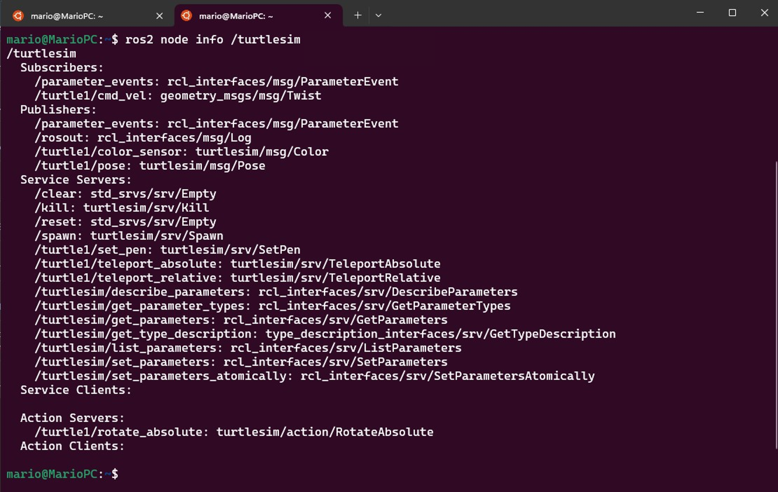

Nodes Command Line
Launching an executable form a package
Example:
Show all the running nodes
Detailed information of the available nodes
ros2 run <package_name> <executable_name>
ros2 node info <node_name>
ros2 node list

Slide 45
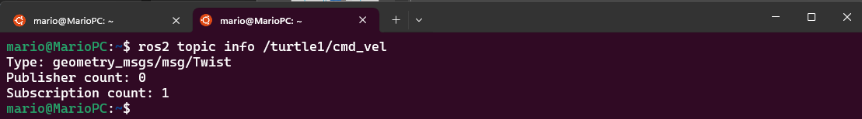
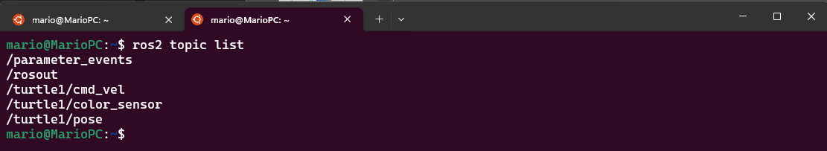
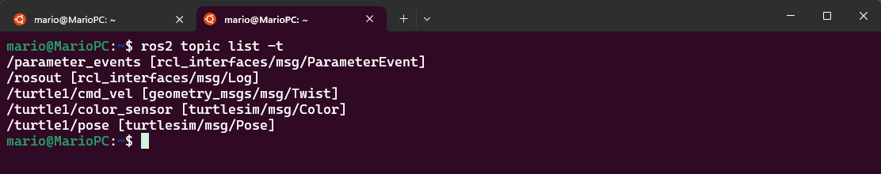
Topics Command Line
List of all the topics currently active in the system
List of all the topics currently active in the system with message information
See the data being published on a topic
ros2 topic info <topic_name>
ros2 topic list
ros2 topic list -t

Slide 46
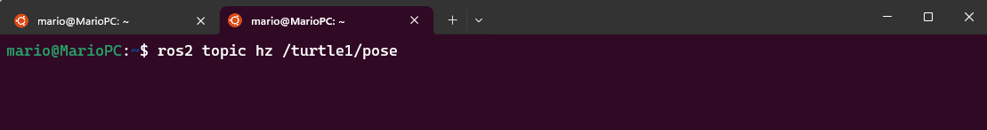
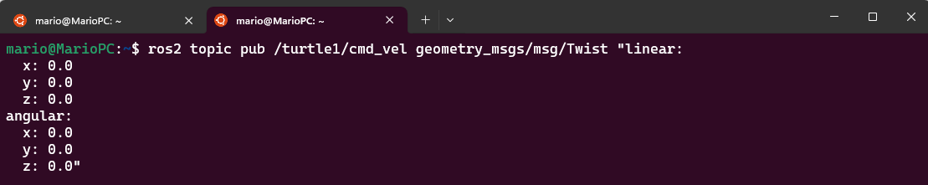
Topics Command Line
Publish data onto a topic directly from the command line
View the rate at which data is published
ros2 topic hz <topic_name>
ros2 topic pub <topic_name> <msg_type> '<args>’
'<args>’ - data to pass to the topic in YAML syntax

Slide 47
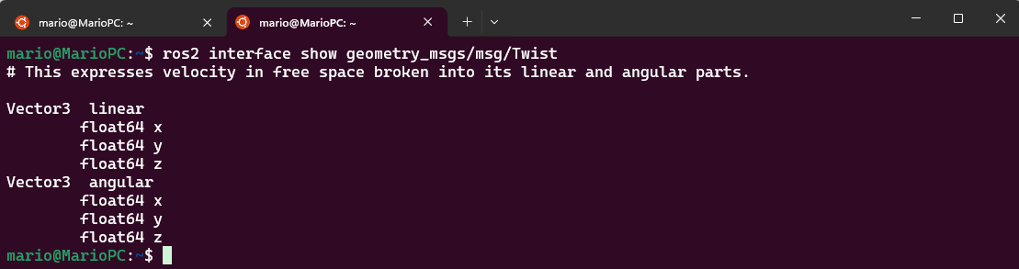
Interface (Messages) Command Line
Publish data onto a topic directly from the command line
ros2 interface show <msg_type>

Slide 48
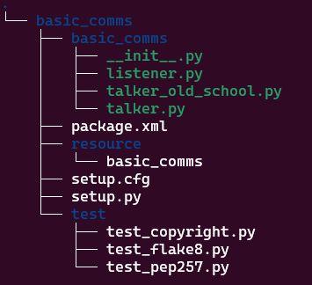
ROS Activity 1
Listener Node
In as in the previous node, create a script called “listener.py” inside the basic_comms package.
Give permission for the node to be executed
Recall that this directory is a Python package with the same name as the ROS 2 package it’s nested in.
Open listener.py in a text editor (e.g. gedit, vscode, vim, …)
$ ~/ros2_ws/src/basic_comms/basic_comms/src
$ touch listener.py
$ sudo chmod +x listener.py

Slide 49
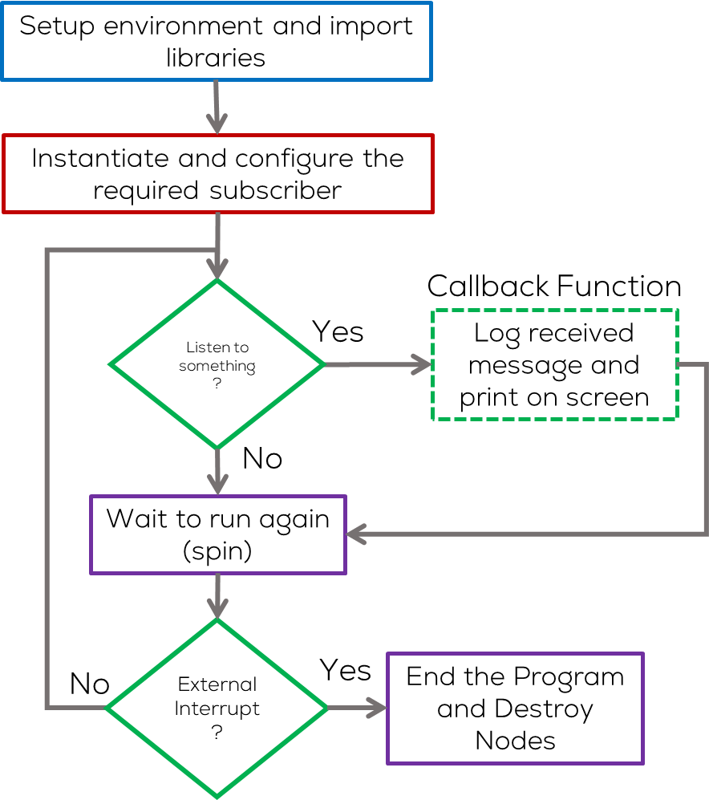
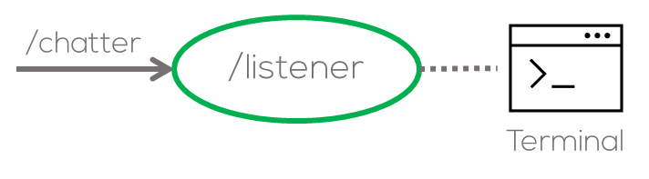
ROS Activity 1
Coding the Listener node
This node will subscribe to the “/chatter” topic and display on terminal the message (String) it has received.
To start, the message will be sent form the terminal (manually) to verify that the node is working properly (debug).
A graphical representation of this task will look as follows
The structure to be used for this node is the following.
Your code will be written in the file “listener.py”.

Slide 50
Option 1: OOP – Listener node (Recommended)
import rclpy
from rclpy.node import Node
from std_msgs.msg import String
class MinimalSubscriber(Node):
def __init__(self):
super().__init__('listener_node')
self.subscription = self.create_subscription(
String, 'chatter', self.listener_callback,10)
self.subscription #No unusedvariable warning
def listener_callback(self, msg):
self.get_logger().info('I heard "%s"' % msg.data)
#Main
def main(args=None):
rclpy.init(args=args)
minimal_subscriber = MinimalSubscriber()
try:
rclpy.spin(minimal_subscriber)
except KeyboardInterrupt:
pass
finally:
if rclpy.ok(): # Ensure shutdown is only called once
rclpy.shutdown()
minimal_subscriber.destroy_node()
#Execute Node
if __name__ == '__main__':
main()
Imports
Main
Constructor
User Stop
(Keyboard Interrupt)
Subscriber callback
Destroy Node
Execute code

Slide 51
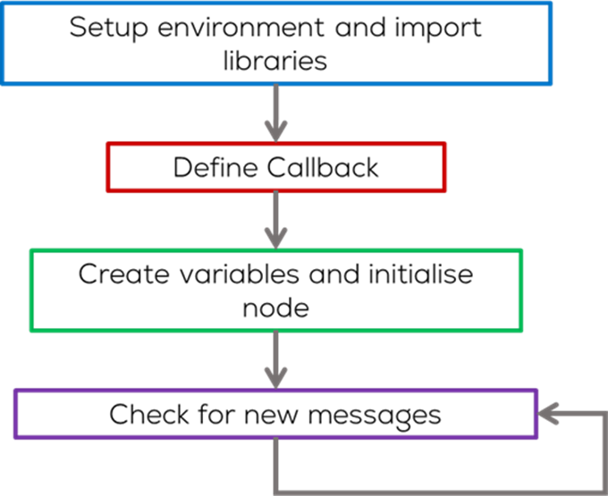
Option 2: Old School– Listener node (Not Recommended)
import rclpy
from rclpy.executors import ExternalShutdownException
from std_msgs.msg import String
g_node = None
def chatter_callback(msg):
global g_node
g_node.get_logger().info(
'I heard: "%s"' % msg.data)
def main(args=None):
global g_node
rclpy.init(args=args)
g_node = rclpy.create_node('minimal_subscriber') subscription = g_node.create_subscription(String, 'chatter', chatter_callback, 10)
subscription # prevent unused variable warning
try:
while rclpy.ok():
rclpy.spin_once(g_node) except (KeyboardInterrupt, ExternalShutdownException):
pass finally:
if rclpy.ok(): # Ensure shutdown is only called once
rclpy.shutdown()
g_node.destroy_node()
if __name__ == '__main__':
main()
Imports
Subscriber
Callback
Configure
the subscriber
Spin
Destroy Node

Slide 52

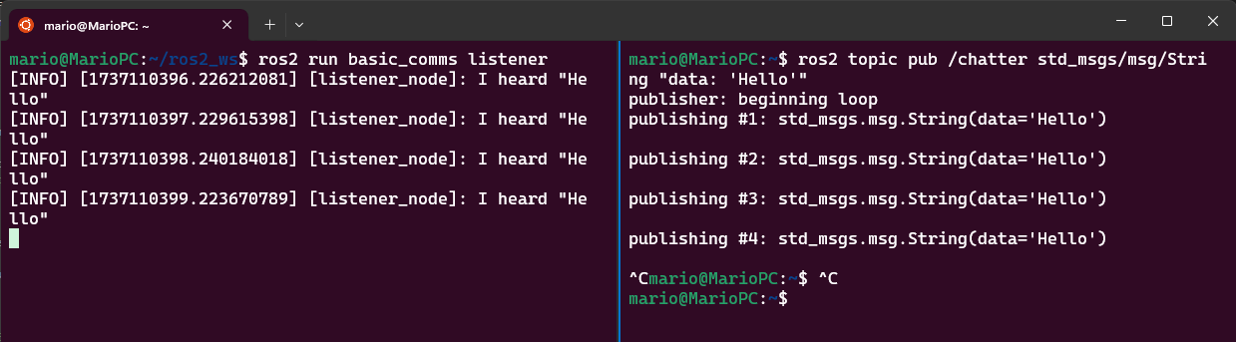
ROS Exercise 1 – Running the node
Results
Add the entry point to the setup.py file
Open a terminal and build your package
Open a new terminal and run the node
To visualize the output of the node, open another terminal and use the command “echo” as follows
entry_points={
'console_scripts': [
'talker = basic_comms.talker:main',
'listener = basic_comms.listener:main',
],
},
$ ros2 topic pub /chatter std_msgs/msg/String "data: Hello"
$ cd ~/ros2_ws
$ colcon build --symlink-install
$ source install/setup.bash
$ ros2 run basic_comms listener
Press “Ctrl+c” at each open terminal to stop the nodes and ROS

Slide 53
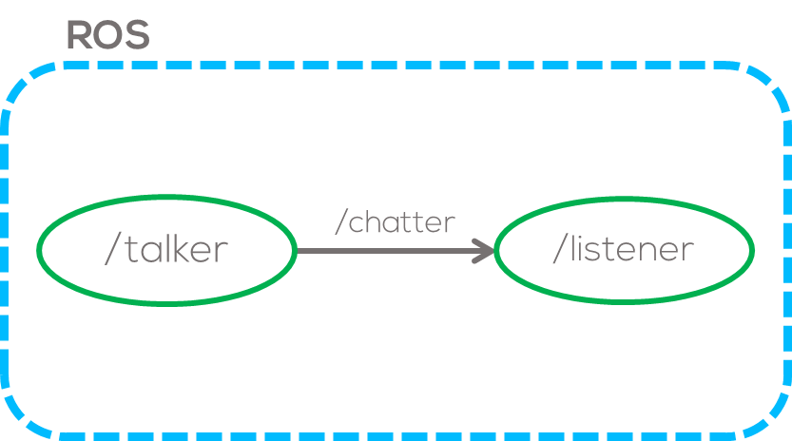
ROS Activity 1
Talker – Listener Nodes
Having developed both nodes, now is time to put everything together and let the nodes to communicate.
This can be achieved in two different ways, manually and via a ROS tool called launch file.

Slide 54
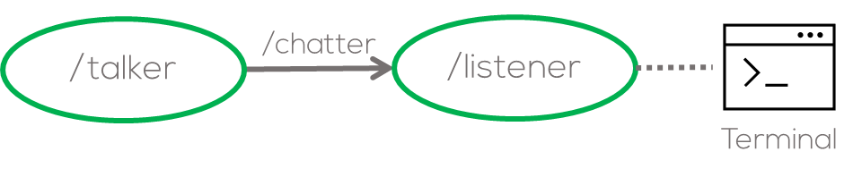
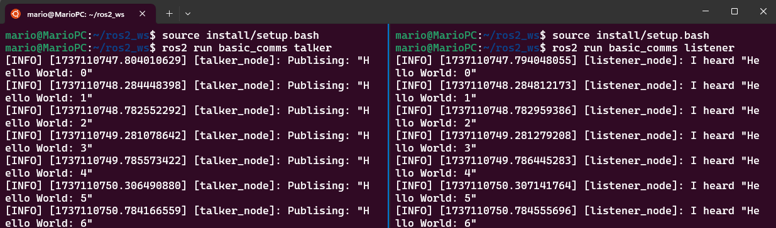
ROS Activity 1 – Running the nodes
Open a new terminal and run the talker node you just made using the following command
Open a new terminal and run the listener node you just made using the following command
Results
$ source install/setup.bash
$ ros2 run basic_comms talker
$ source install/setup.bash
$ ros2 run basic_comms listener
Press “Ctrl+c” at each open terminal to stop the nodes and ROS

Slide 55
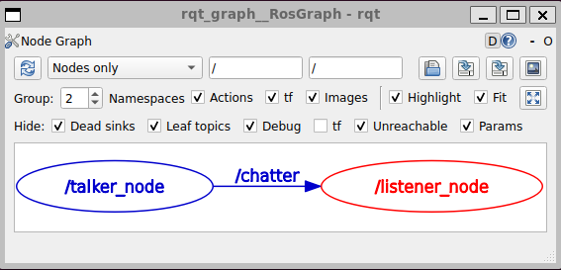
ROS Tools for Debugging
rqt
Visualization tool that provides graphical information of the nodes and system status.
Ros2 run rqt_plot: Displays scalar data published to ROS topics.
ros2 run rqt_graph: Displays a visual graph of the processes running in ROS and their connections
Using the previous example, open another terminal and type the following
$ ros2 run rqt_graph rqt_graph

Slide 56
Robot Operating System - ROS
ROS Launch Files

Slide 57

ROS2 Launch file
Launch Files
Launch files are sets of commands written in Python, .xml, and .yaml that allow the simultaneous execution of various scripts.
Launch files allow you to run any object used within the ROS2 architecture.
A wide variety of tools allow you to parametrise the launch file and adapt it to a project's requirements.

Slide 58

Launch files
Launch files allow you to start up and configure several executables containing ROS 2 nodes simultaneously.
Running a single launch file with the ros2 launch command will start up your entire system - all nodes and their configurations - at once.
To use a launch file
$ ros2 launch <package_name> <file_name>

Slide 59

Launch files
The user can set parameters used by the nodes in ROS.
The user can also set arguments used by the ROS launch files and nodes in ROS.
All the processes will shut down when the ROS launch process is killed (ctrl+C).
ROS Launch files are usually located inside a folder called “launch” in each package.

Slide 60
Robot Operating System - ROS
Activity 1 .2- Making a Launch File

Slide 61
ROS Activity 1(Launch file)
For exercise 1, a ROS Launch file will be developed as follows.
Make the launch file directory inside the “basic_comms” package.
Make a launch file and give exedcutable permissions inside the previous folder
For this exercise, the talker and listener nodes (previously done) will be launched.
$ cd ~/ros2_ws/src/basic_comms
$ mkdir launch
$ cd launch
$ touch activity1_launch.py
$ chmod +x activity1_launch.py
IMPORTANT NOTE
Launch files must be named as follows:
<NAME>_launch.py #Replace <NAME> with a name set by the user

Slide 62
ROS2 Launch file
from launch import LaunchDescription
from launch_ros.actions import Node
def generate_launch_description():
talker_node = Node(package='basic_comms',
executable='talker',
output='screen'
)
listener_node = Node(package='basic_comms',
executable='listener',
output='screen'
)
l_d = LaunchDescription([talker_node,listener_node])
return l_d
Open activity1_launch.py in a text editor (e.g. gedit, vscode, vim, …), write and save the launch code given in the snippet.
Open the setup.py file and add the following lines at the top.
Add the following inside “data_files”
Imports
Node to be Launched
import os
from glob import glob
Node to be Launched
data_files=[
('share/ament_index/resource_index/packages',
['resource/' + package_name]),
('share/' + package_name, ['package.xml']),
(os.path.join('share', package_name, 'launch'), glob(os.path.join('launch', '*launch.[pxy][yma]*'))),
],
Set launch content

Slide 63


ROS Activity 1 (Launch file)
To run the roslaunch file, open a terminal and type
Run the launch file using the following command
Results
Running the ROS tool “rqt_graph” it is possible to observe the nodes currently active
$cd ~/ros2_ws
$ colcon build
$ source install/setup.bash
$ ros2 run rqt_graph rqt_graph
$ ros2 launch basic_comms activity1_launch.py

Slide 64


Q&A
Questions?

Slide 65
Thank You
Robotics For Everyone

Slide 66
T&C
Terms and conditions

Slide 67
Terms and conditions
THE PIECES, IMAGES, VIDEOS, DOCUMENTATION, ETC. SHOWN HERE ARE FOR INFORMATIVE PURPOSES ONLY. THE DESIGN IS PROPRIETARY AND CONFIDENTIAL TO MANCHESTER ROBOTICS LTD. (MCR2). THE INFORMATION, CODE, SIMULATORS, DRAWINGS, VIDEOS PRESENTATIONS ETC. CONTAINED IN THIS PRESENTATION IS THE SOLE PROPERTY OF MANCHESTER ROBOTICS LTD. ANY REPRODUCTION, RESELL, REDISTRIBUTION OR USAGE IN PART OR AS A WHOLE WITHOUT THE WRITTEN PERMISSION OF MANCHESTER ROBOTICS LTD. IS STRICTLY PROHIBITED.
THIS PRESENTATION MAY CONTAIN LINKS TO OTHER WEBSITES OR CONTENT BELONGING TO OR ORIGINATING FROM THIRD PARTIES OR LINKS TO WEBSITES AND FEATURES IN BANNERS OR OTHER ADVERTISING. SUCH EXTERNAL LINKS ARE NOT INVESTIGATED, MONITORED, OR CHECKED FOR ACCURACY, ADEQUACY, VALIDITY, RELIABILITY, AVAILABILITY OR COMPLETENESS BY US.
WE DO NOT WARRANT, ENDORSE, GUARANTEE, OR ASSUME RESPONSIBILITY FOR THE ACCURACY OR RELIABILITY OF ANY INFORMATION OFFERED BY THIRD-PARTY WEBSITES LINKED THROUGH THE SITE OR ANY WEBSITE OR FEATURE LINKED IN ANY BANNER OR OTHER ADVERTISING.

